Slide 1

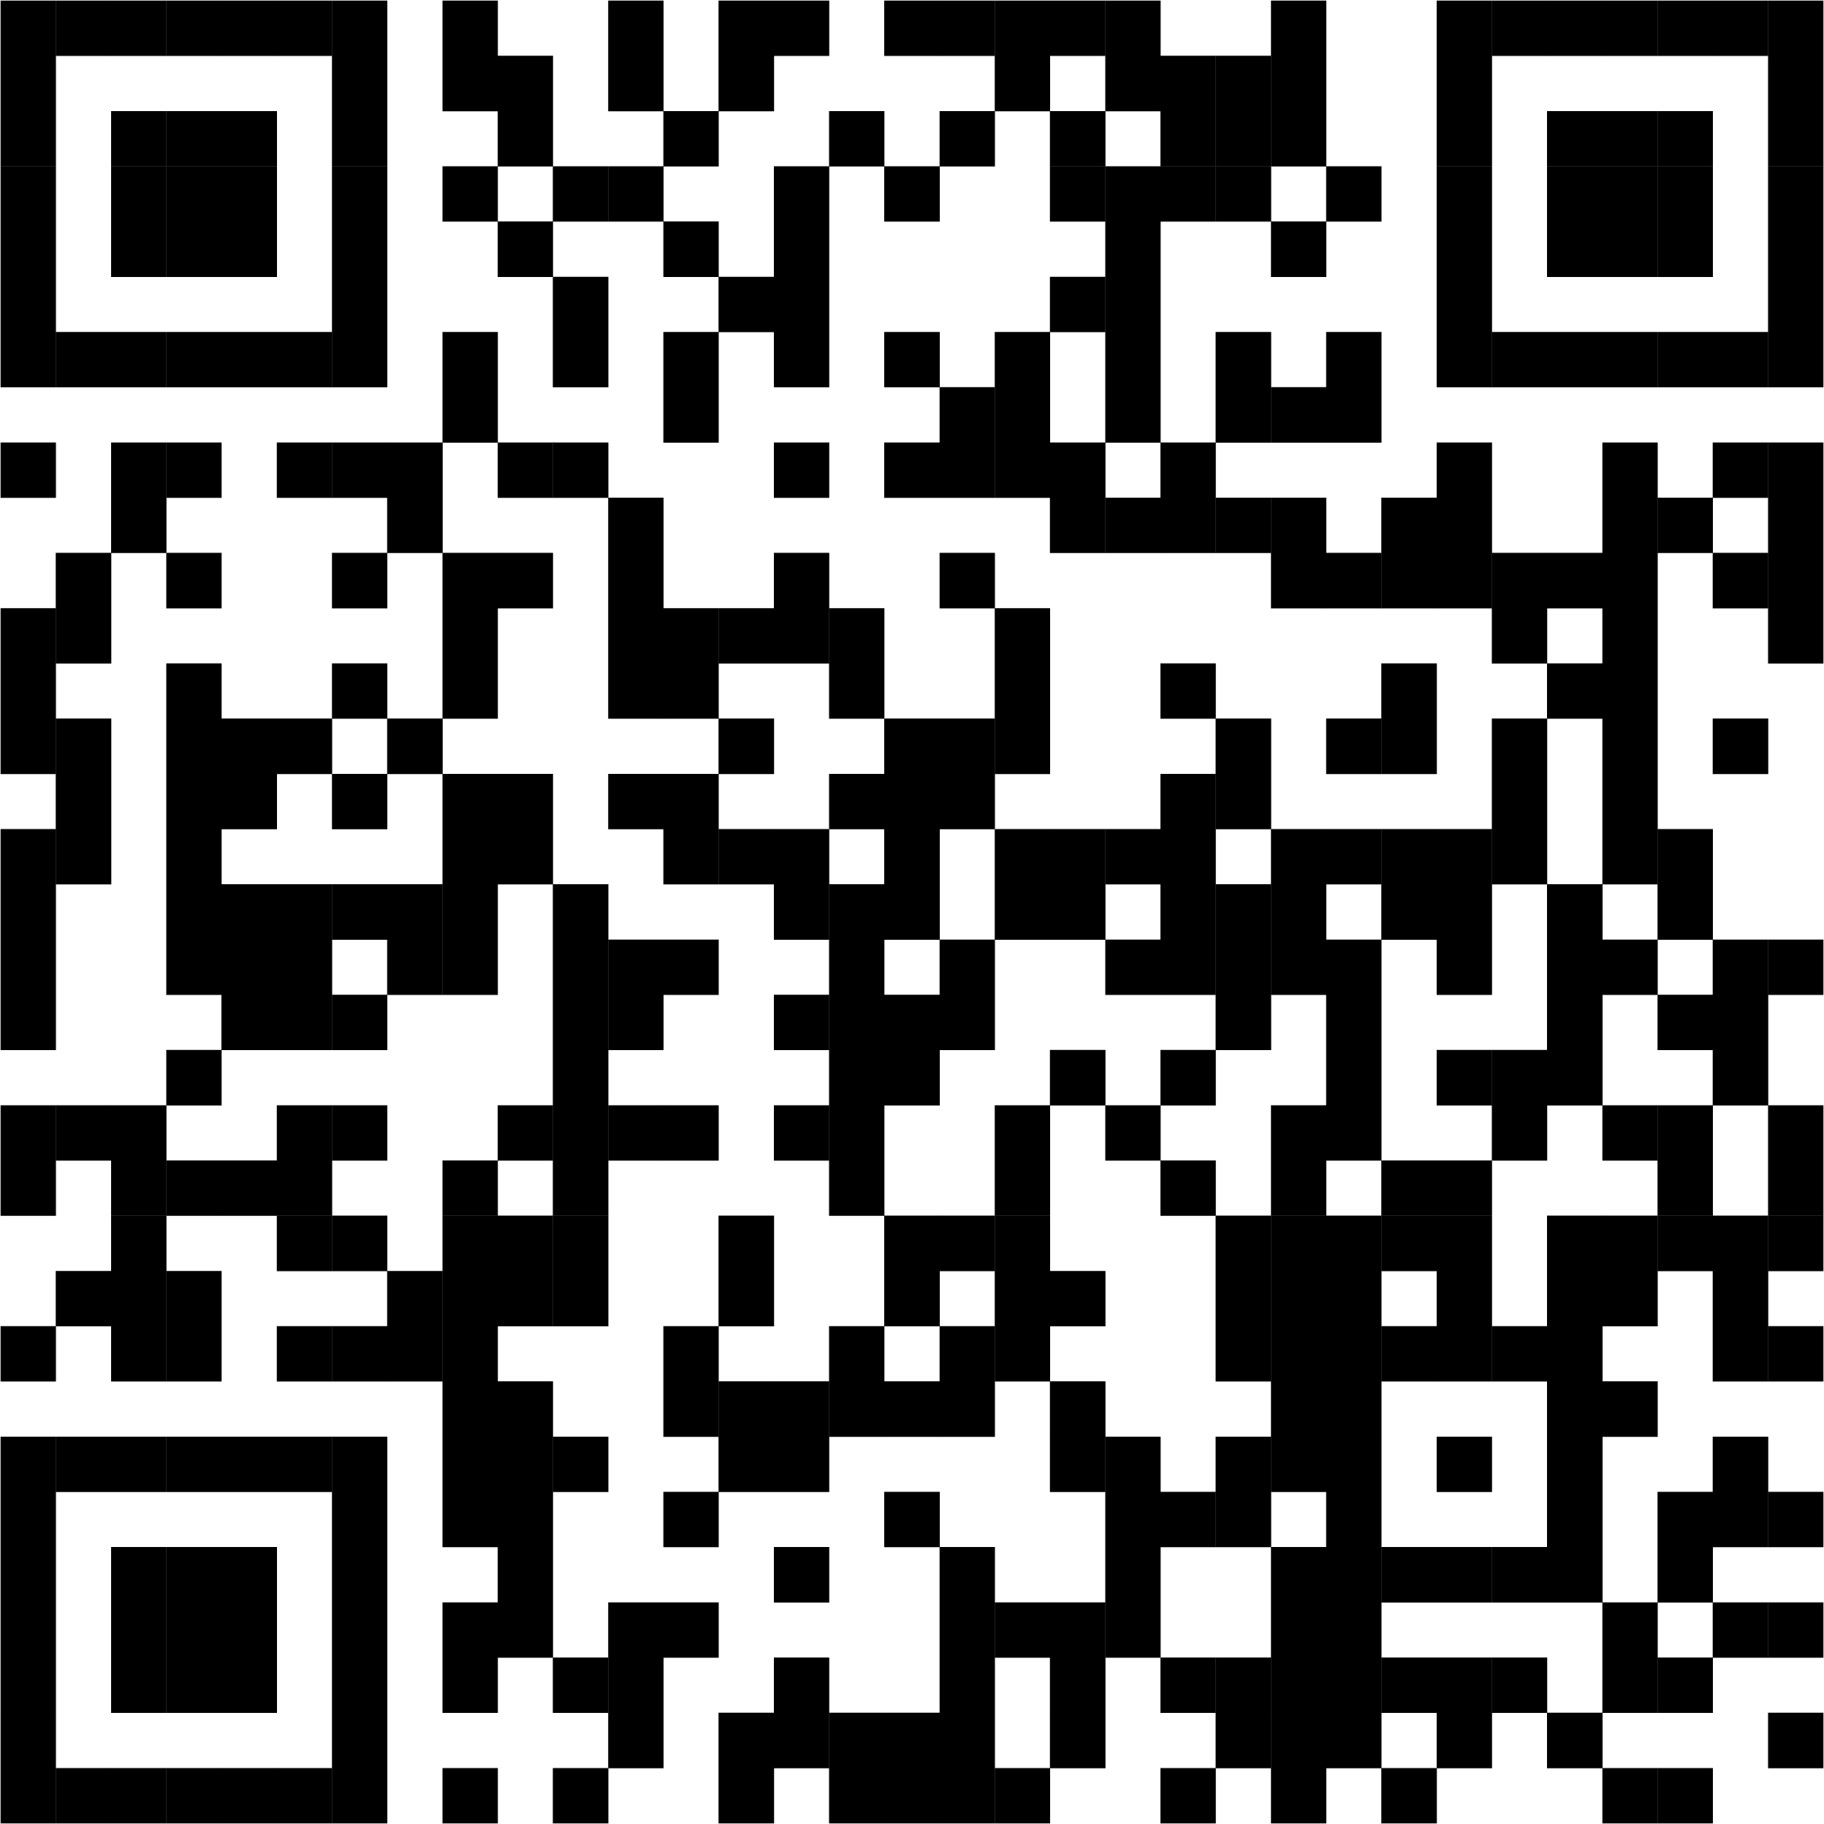


Are You An Unpaid Carer?
A carer is someone who provides support to someone who could not manage without their help.
This may be due to physical or mental ill-health, frailty, disability, alcohol or drug dependency.
Caring can include shopping, domestic tasks, emotional assistance and personal care.
A young carer is under 18 years old or 18 if still at school.
Support is available to those in a caring role. For more information visit www.aberdeenshire.gov.uk/carersupport
or scan the QR code.

Slide 2


Slide 3


Slide 4
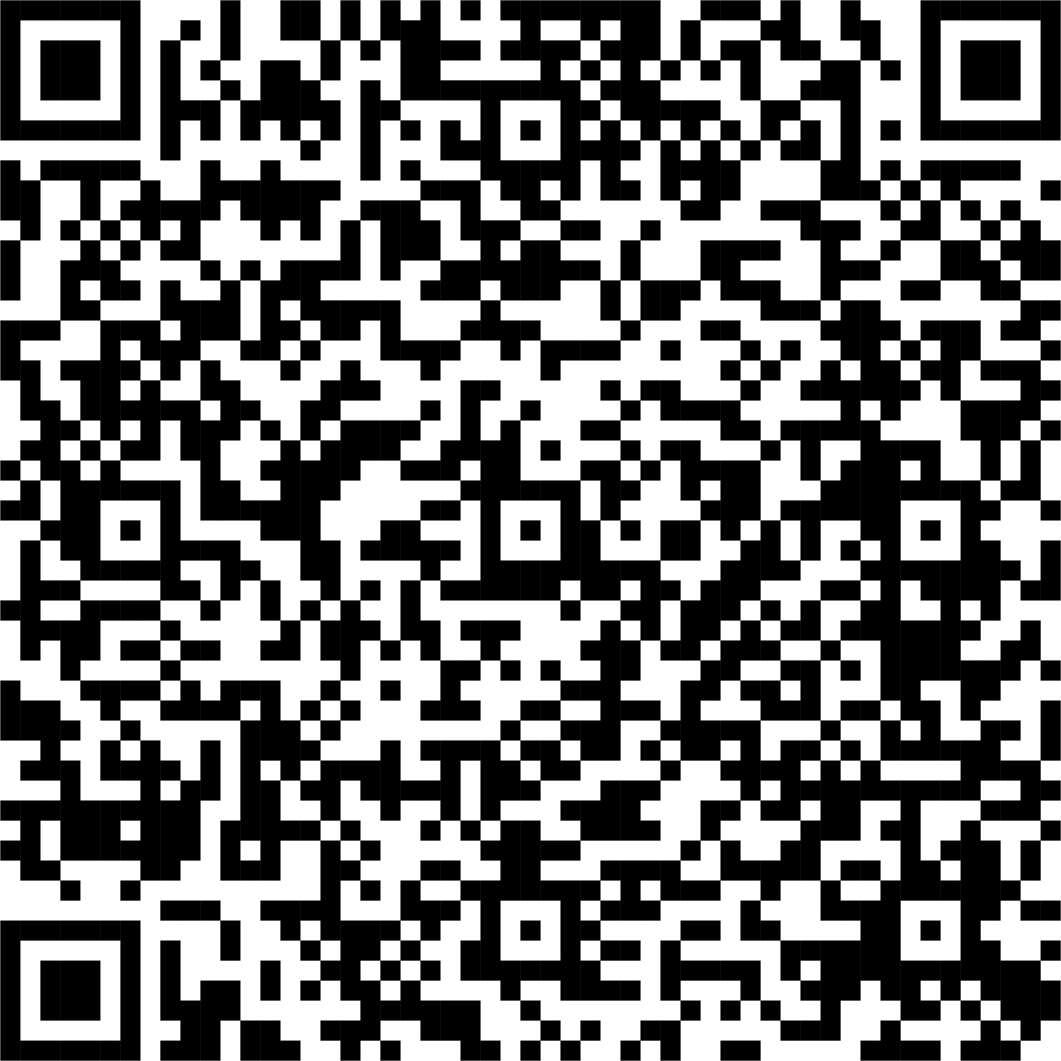
Aberdeenshire Unpaid Carers Information Pack
The pack contains information that unpaid carers in Aberdeenshire and professionals working with unpaid carers, told us they would find useful to have all in one place.
Local Support Services
Useful contacts for Carers
Concessions for Carers
Financial Information
Carers Support groups
To access the Information Pack, scan the QR code or visit www.aberdeenshire.gov.uk/carersupport

Slide 5

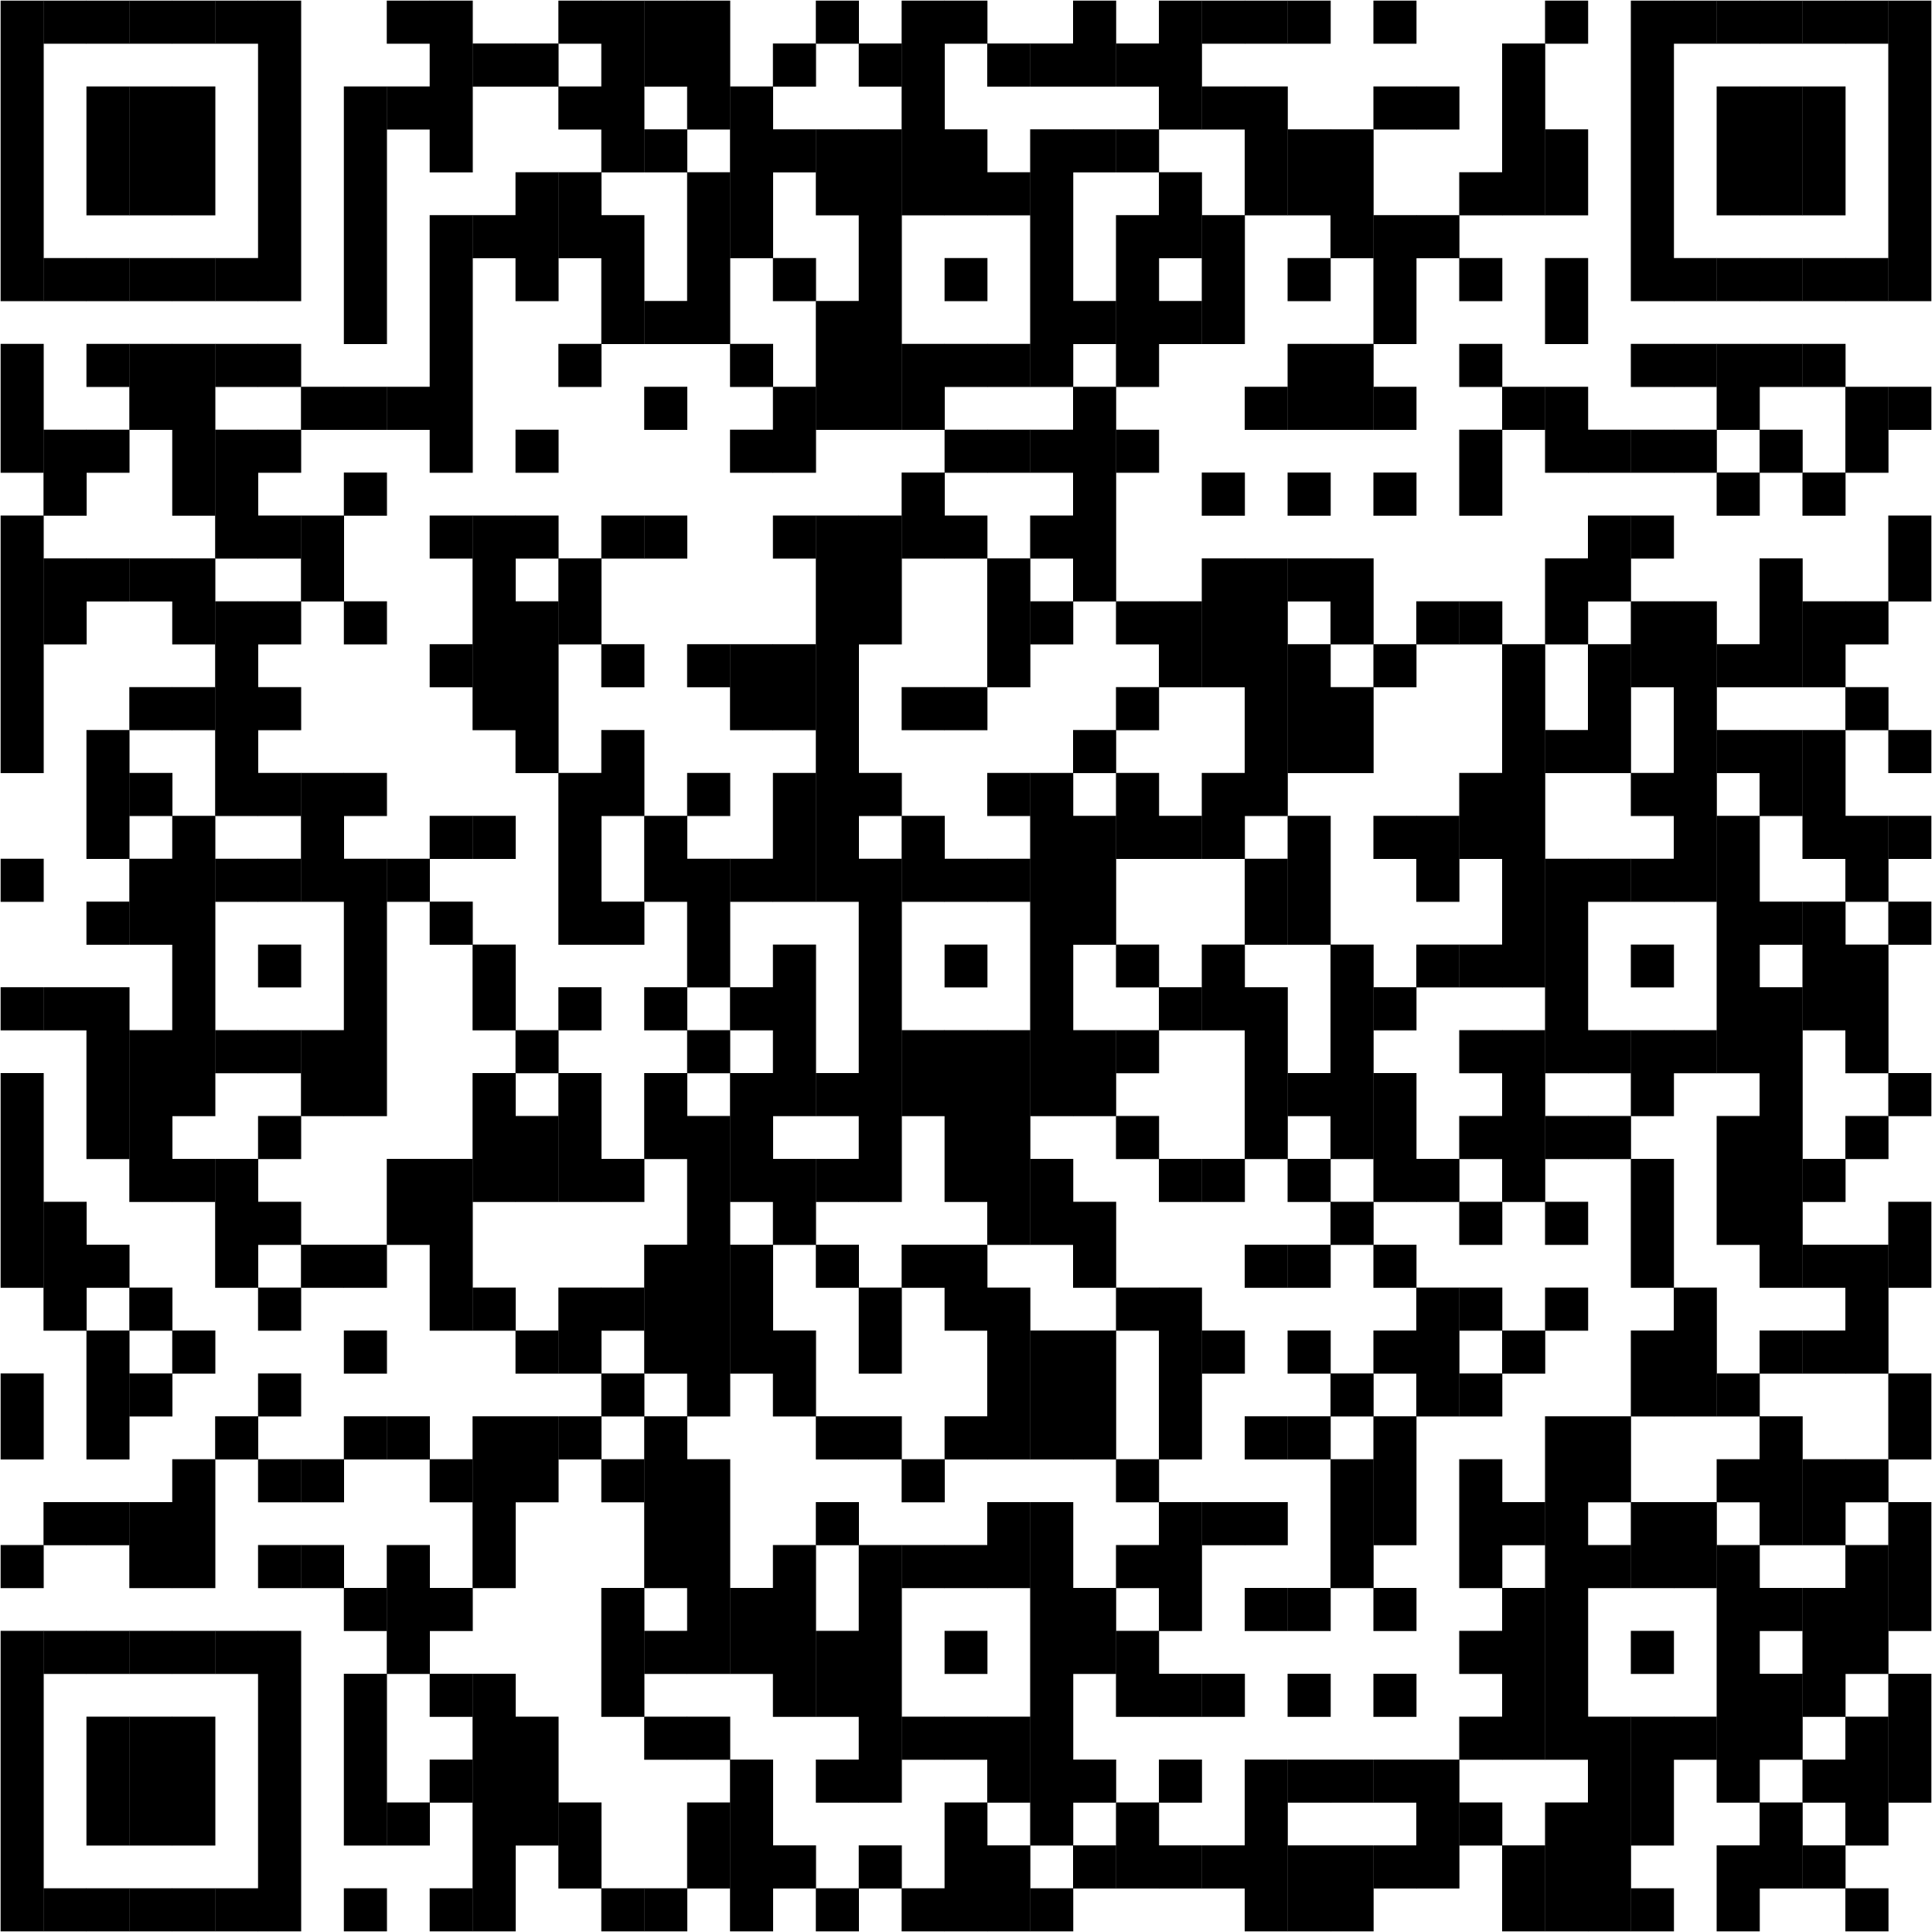
Short Breaks Bureau
The Short Breaks Bureau helps carers and those they care for to access personalised short breaks. We provide practical advice and support for planning breaks which can be:
A few hours, overnight, or several weeks
Taken together with the person they care for, separately, or in groups
In specialist facilities, adapted accommodation, or regular hotels or cottages
For more information scan the QR code or visit
www.aberdeenshire.gov.uk/shortbreaks-bureau
E-mail: shortbreaks@aberdeenshire.gov.uk

